Slide 1
The Astronauts

Slide 2
01
TABLE OF CONTENTS
02
03
Our team
Stages of development
Used programs

Slide 3
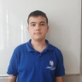
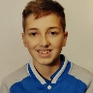
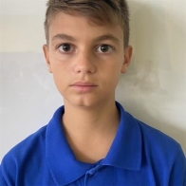
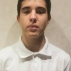
Our team
Nikolay Stoyanov
Dimitar Byandov
Vicho Vichev
Martin Nenkov
Scrum
Trainer
Frontend developer
Backend developer
QA
engineer

Slide 4
Stages of development
Forming our team
Working on the project
Creating our ideas
Presenting

Slide 5







Used programs

Slide 6

Let’s jump to our project!

